Slide 1

END TERM PRESENTATION
- DOmmalapati navya
Integrated Mentoring Program for Advanced Career Technology

Slide 2

Productivity App
Login
Create New Project
Assign Employees
Timesheet Form Filling
Review Timesheets

Slide 3
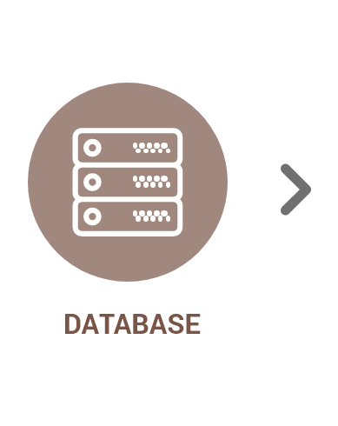

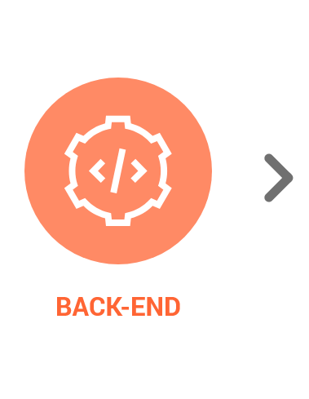



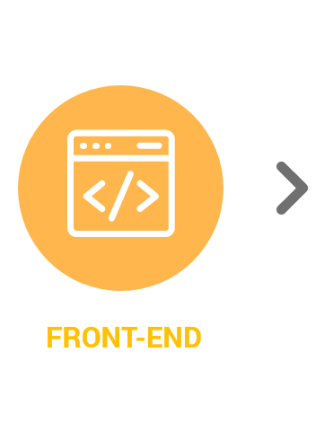


System Architecture

Slide 4

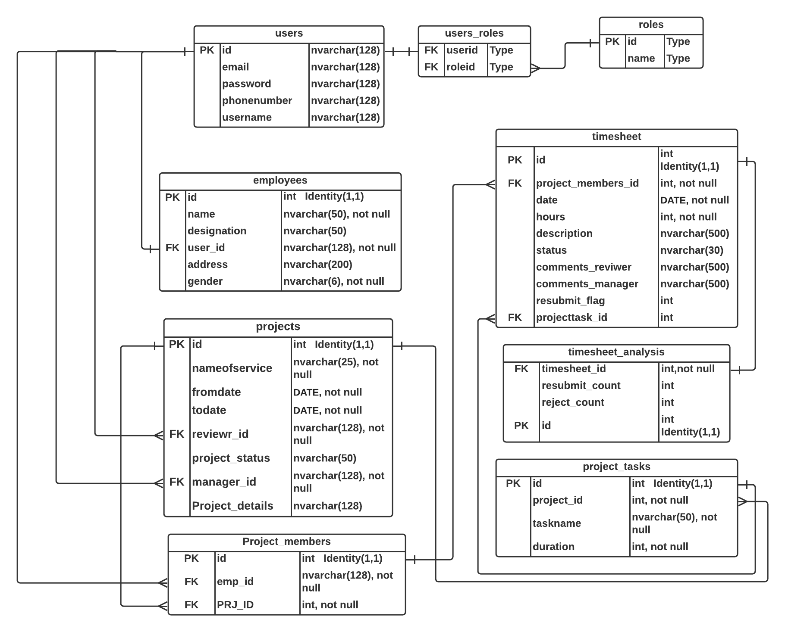



Data
Model

Slide 5

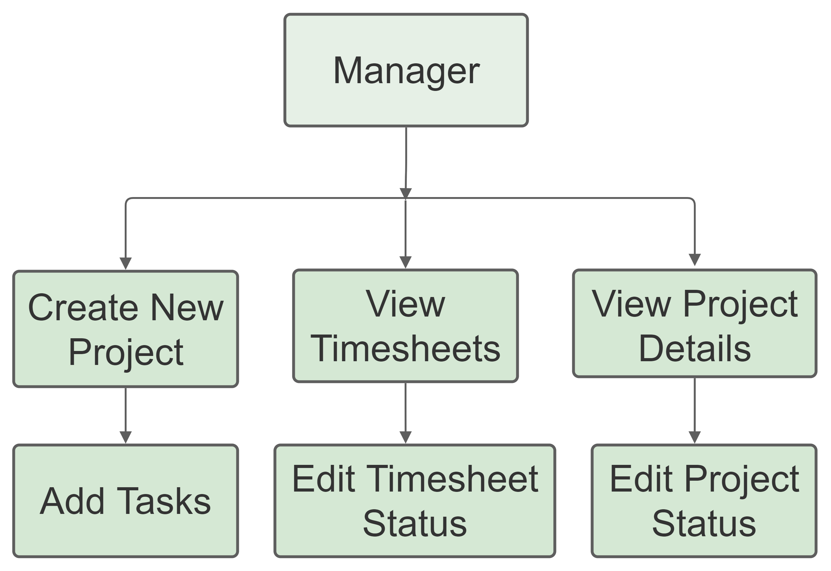
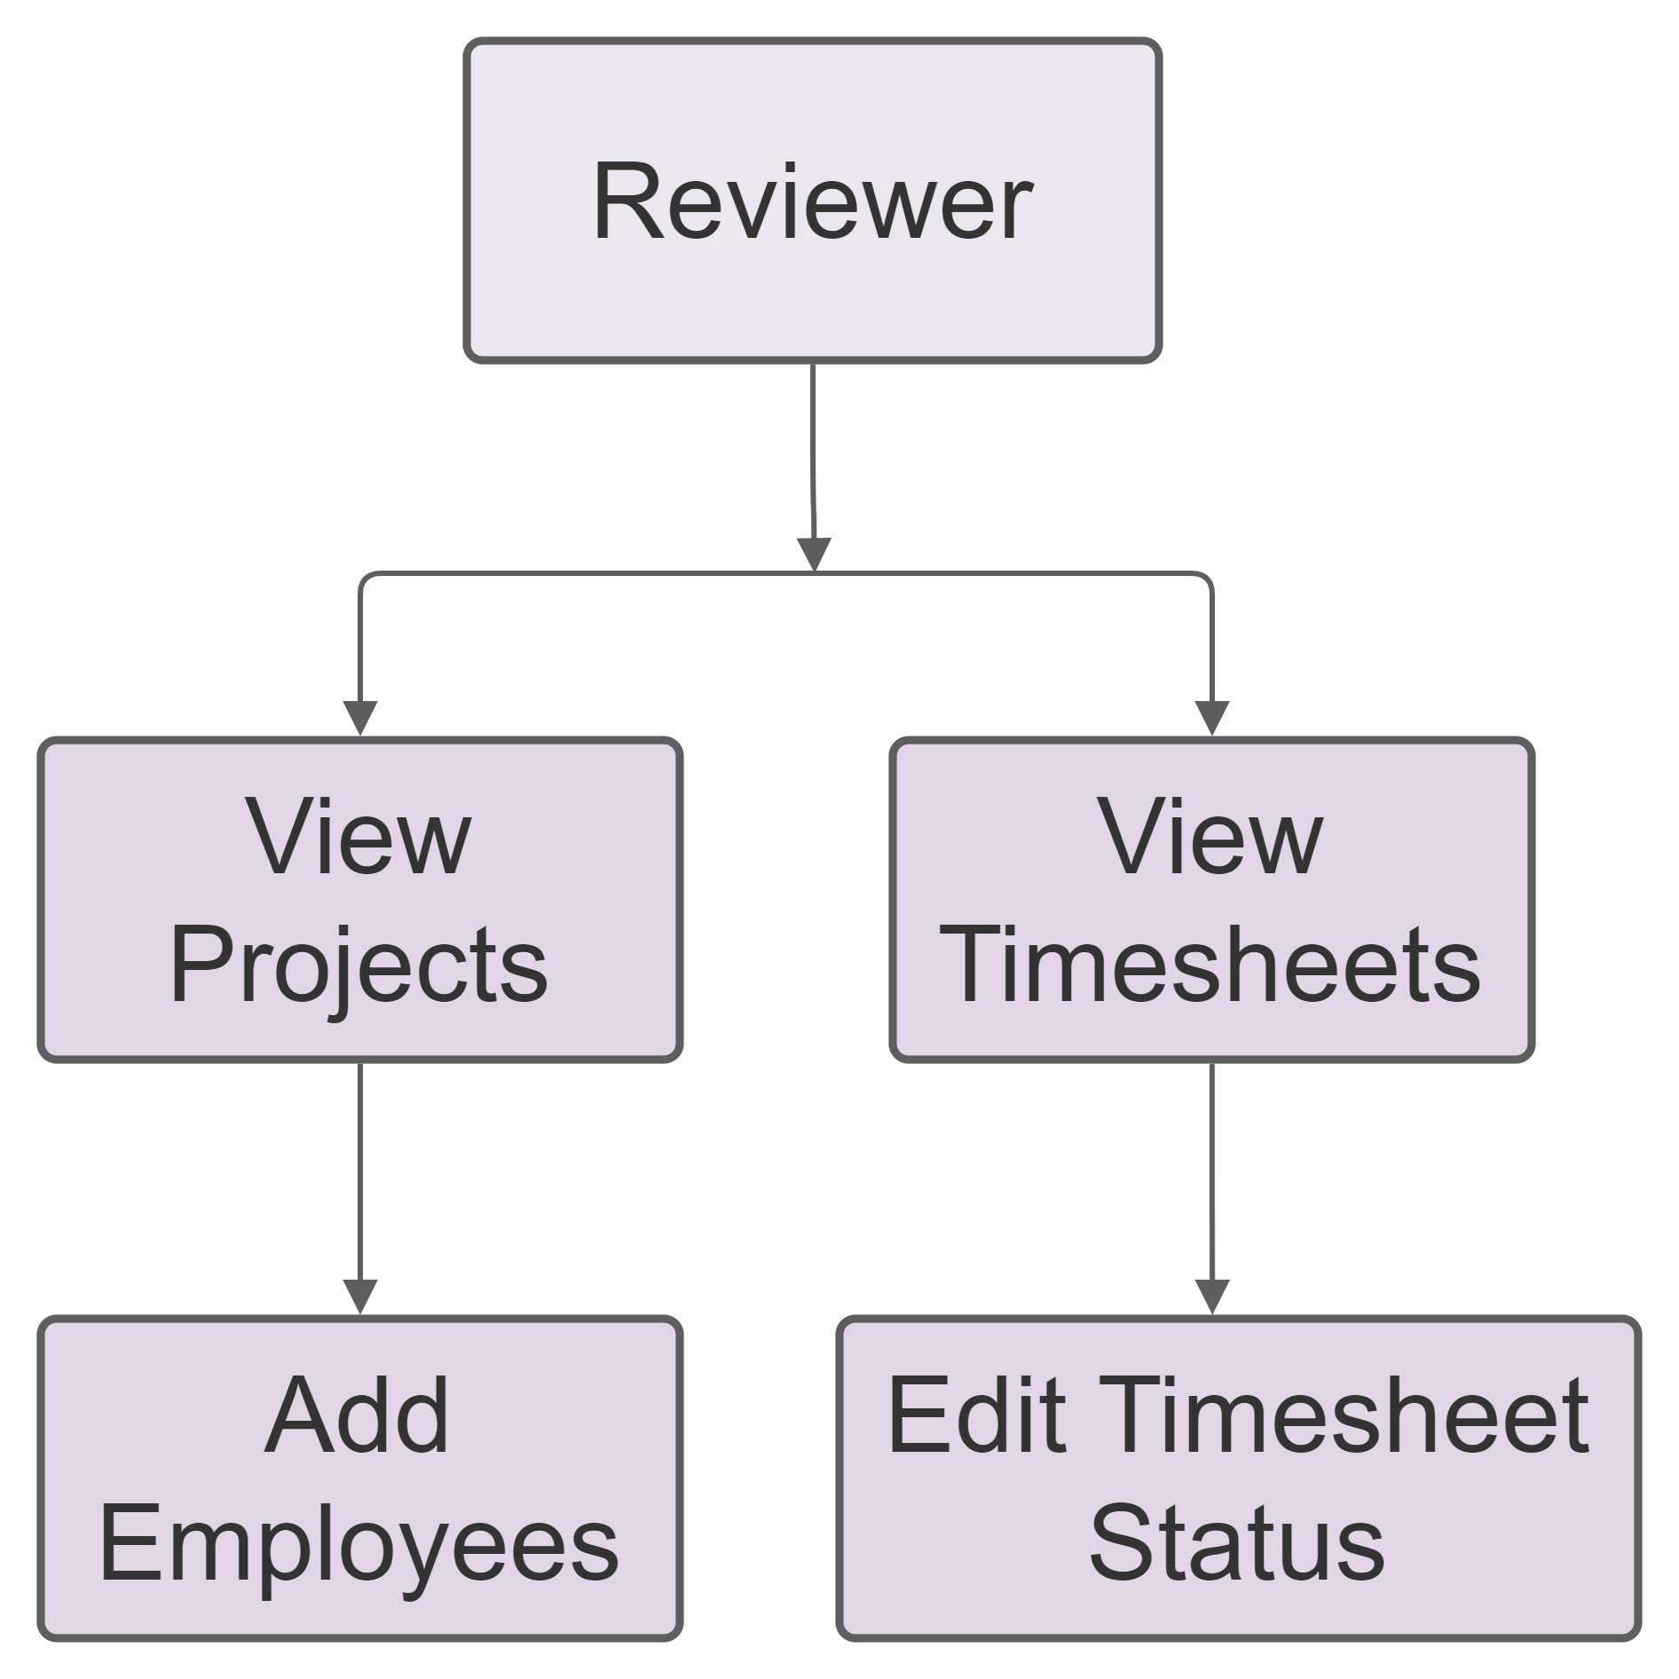
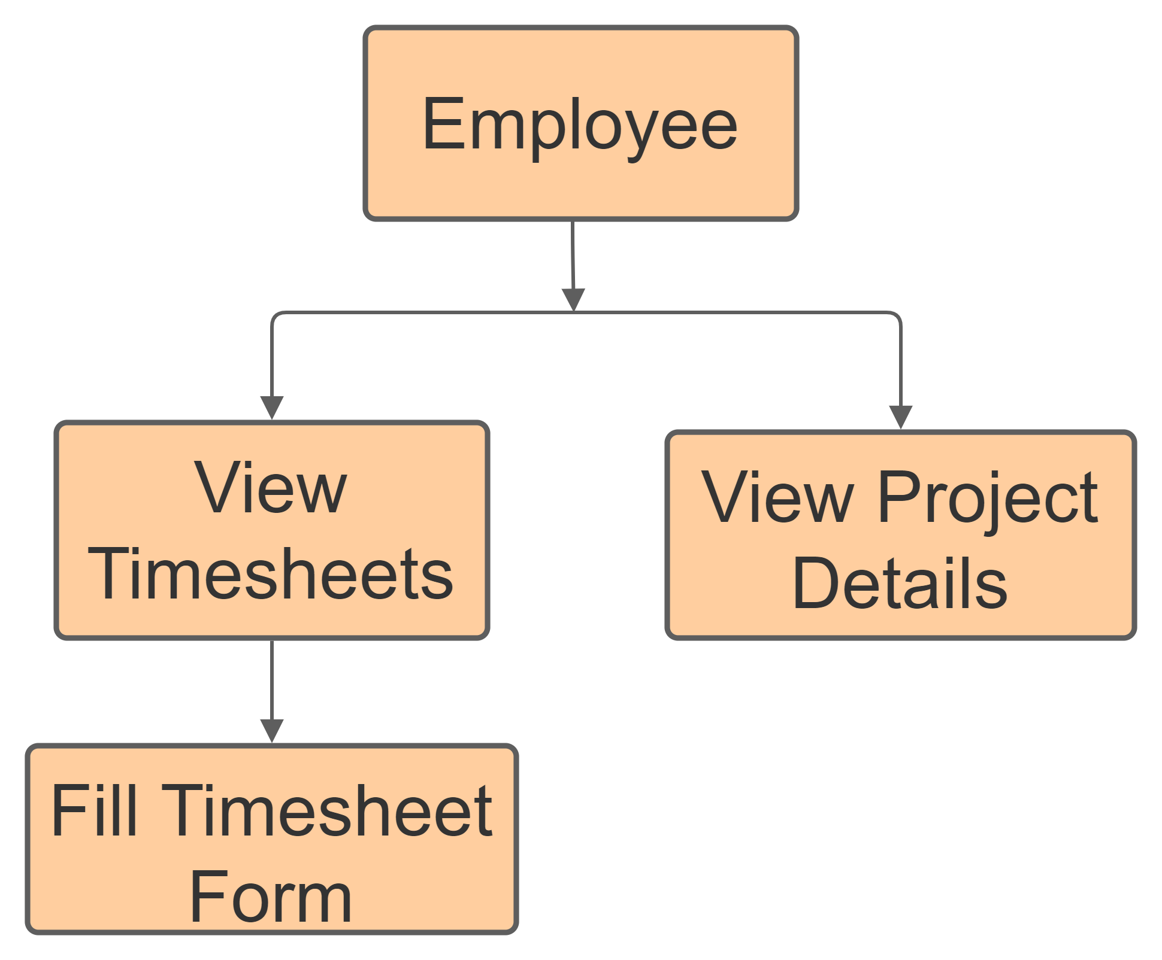

Roles

Slide 6
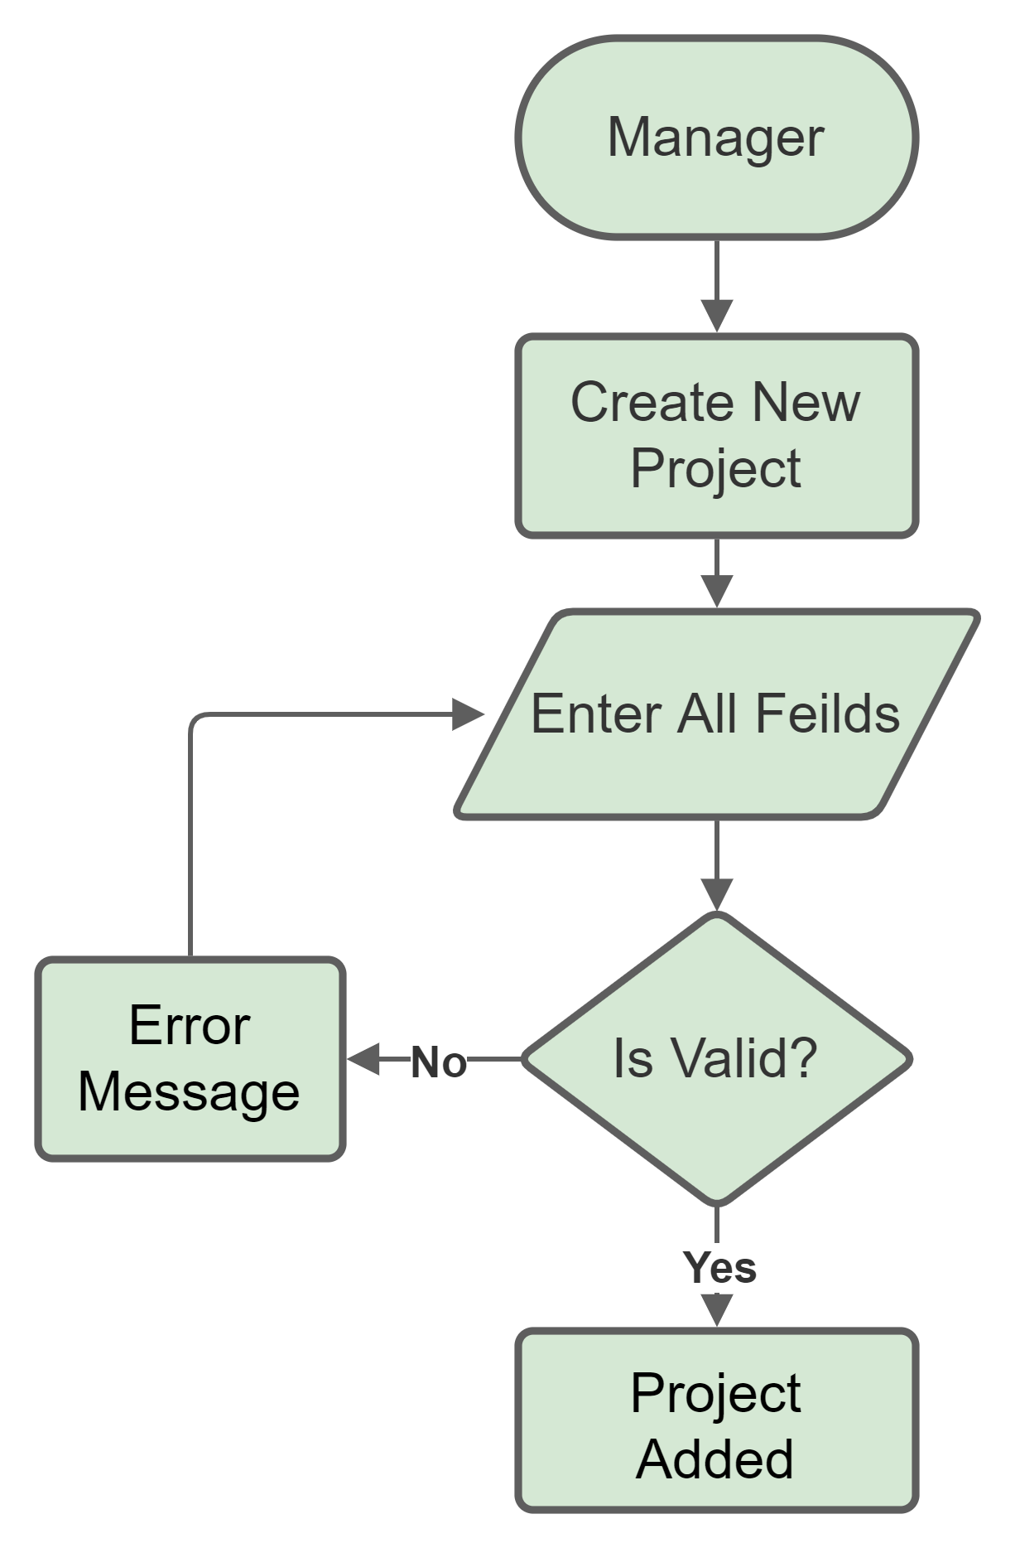
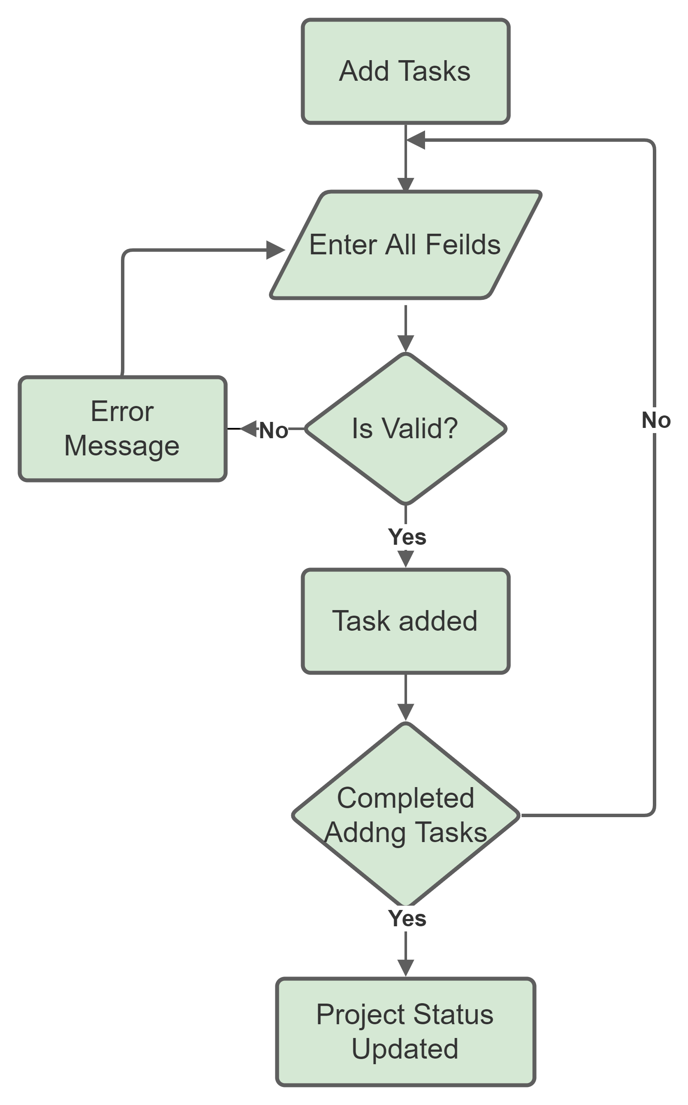
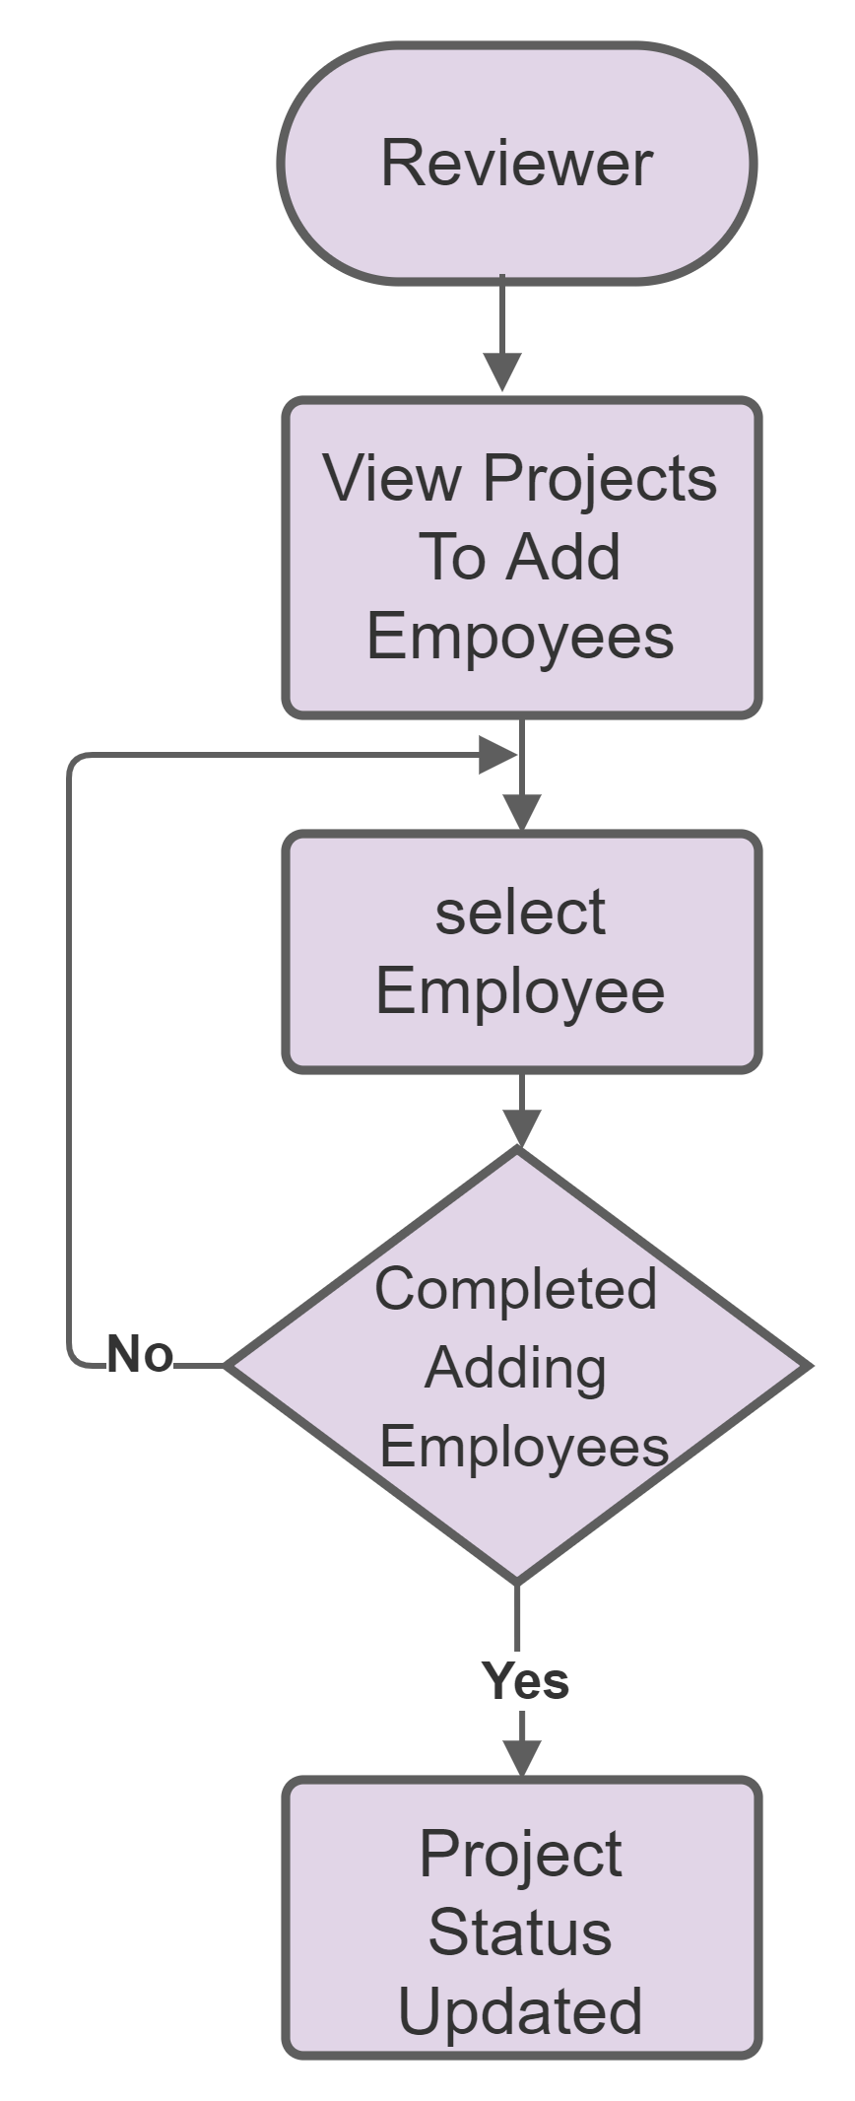
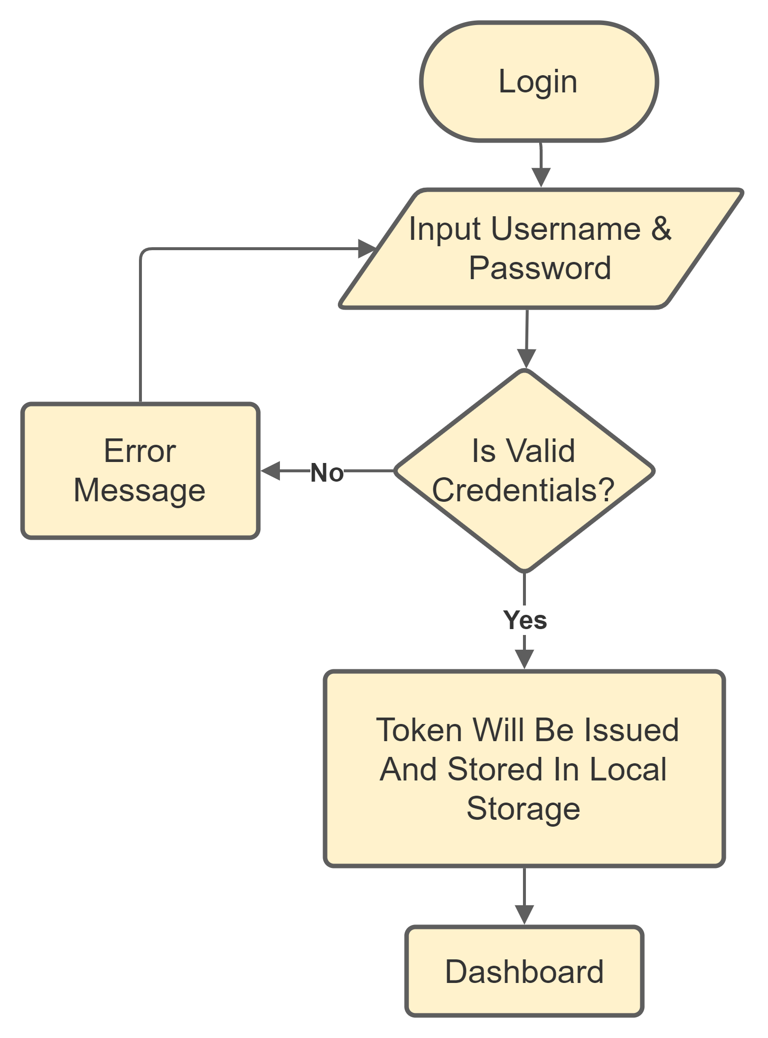
Process Flow
Process Flow

Slide 7
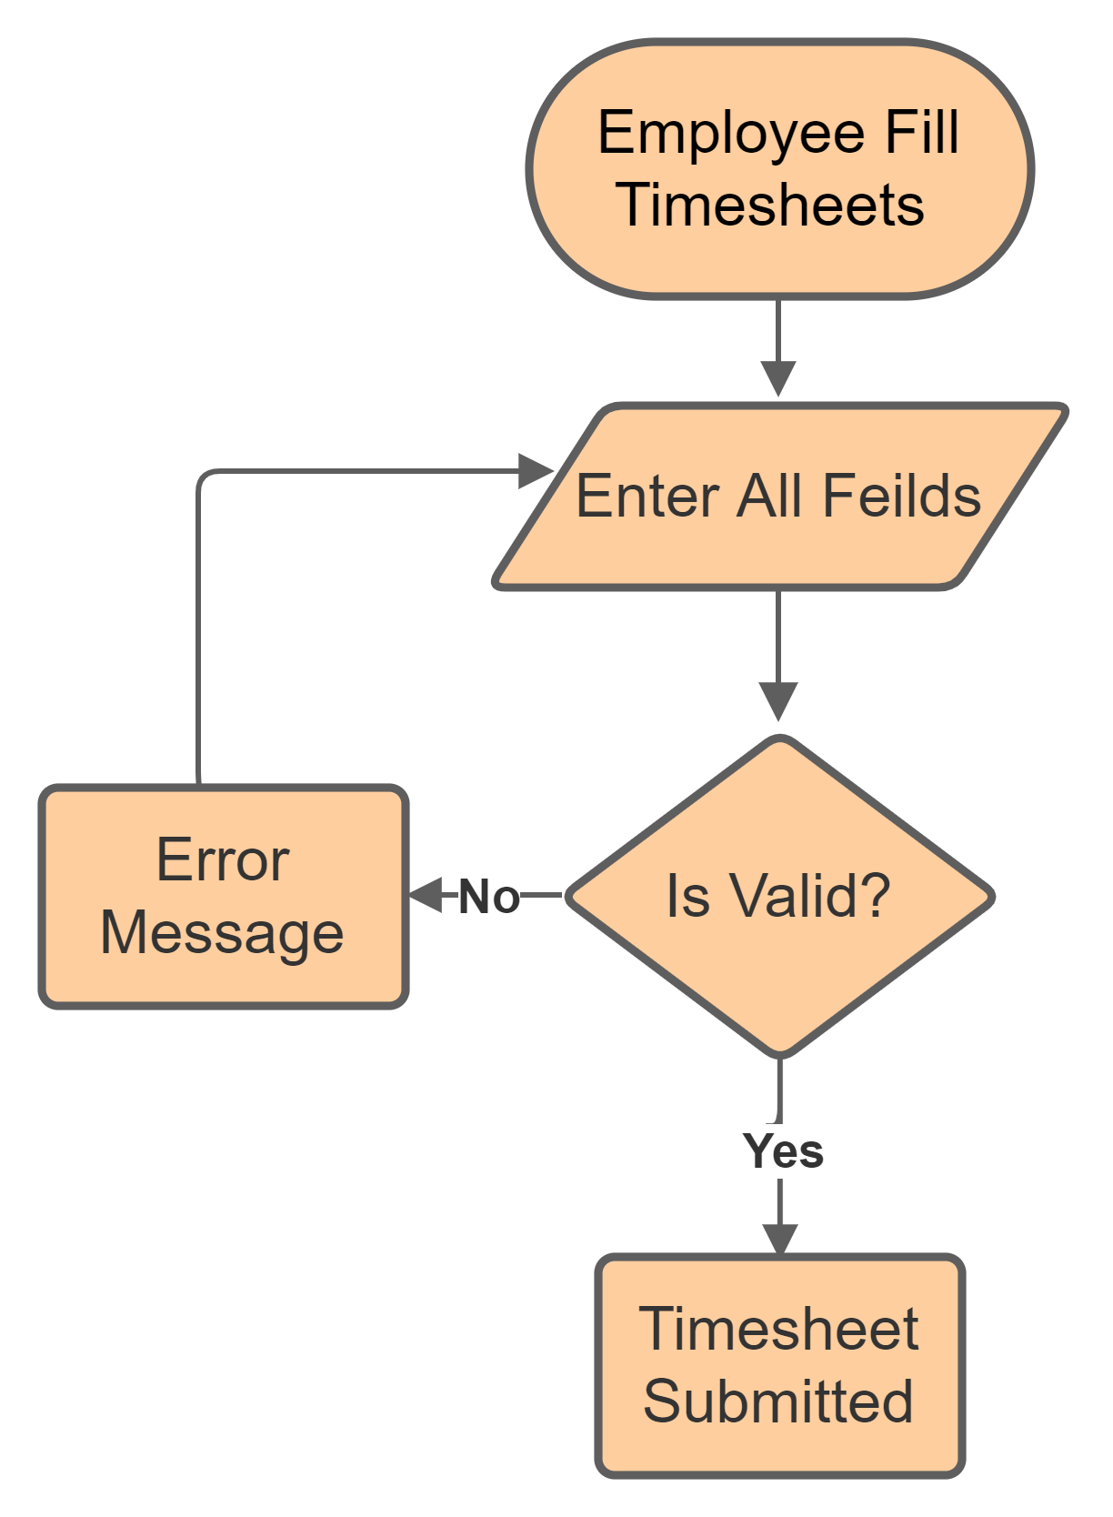
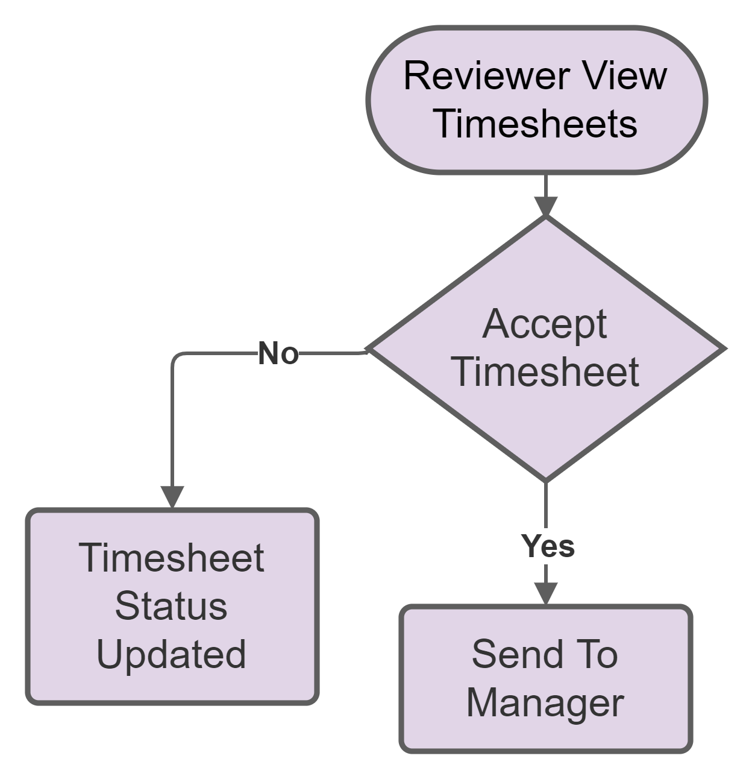
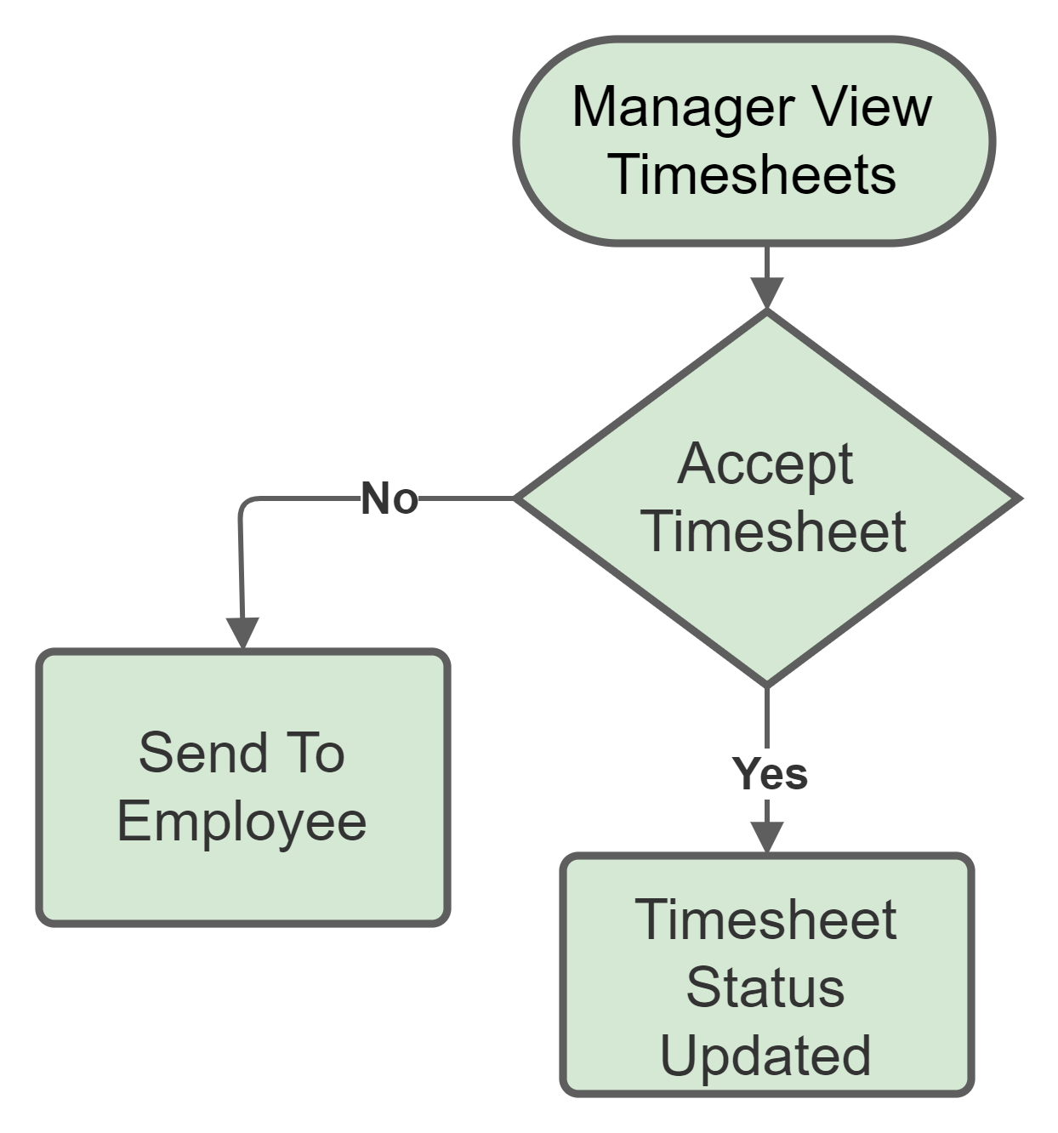
Process Flow
Process Flow
Process Flow

Slide 8




App Features
Mail Notification
Dashboard
Dark/Light Theme
Error Logging

Slide 9
To Generate Project Reports
Analytics Based On Previous Projects
To Add Few More Pages
Future Enhancements

Slide 10

Personal Website
App Using JavaScript
Full Stack App
My Impact Journey

Slide 11
Thank You

